Slide 1



CO7217- AGILE CLOUD AUTOMATION 2023-24 MINI PROJECT 1
Insight about the airline delays by airports(2003-2016) monthly
Presenters:
Adarsh mirajkar - am1501
ANSHIKA BARANWAL- AB1258
ATHARVA MALI – ama79
GOPINATH VARADARAJAN - GV58
RUPA PYARAM - REP32

Slide 2
Exercise 1: Choosing Json dataset
We have selected the airlines dataset for our project.
This dataset is being used because
superior and logically structured
Controllable and diverse data
Possibility of visualization
Relevance in real world
Accessible to both basic and complicated queries
Clean data
User-aam79

Slide 3
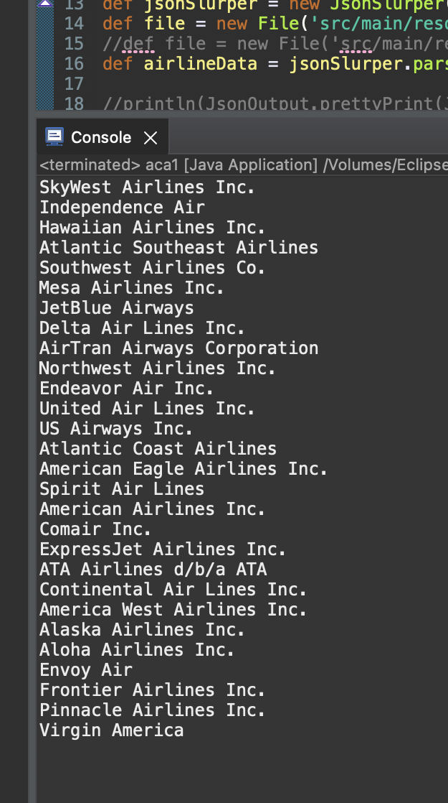
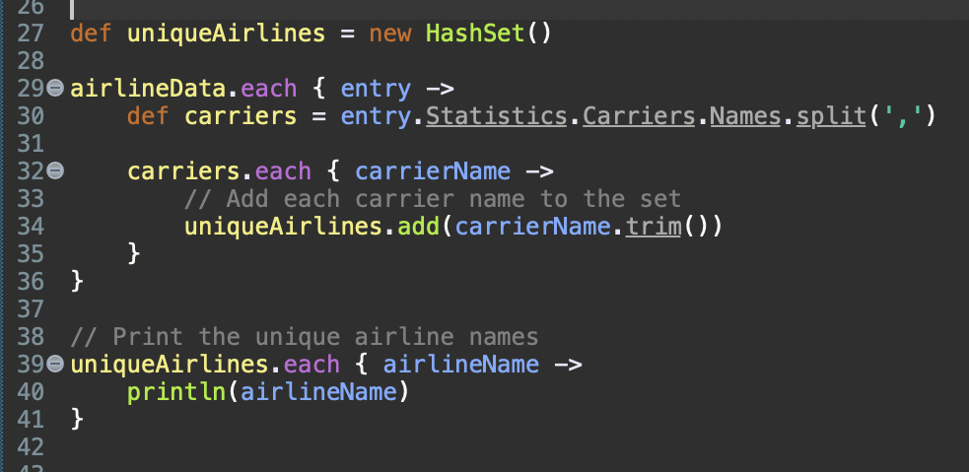
Illustration of below queries
Query 1 – Data selection
Query to print all the different Unique Airlines
Code:
Output:
User-aam79

Slide 4
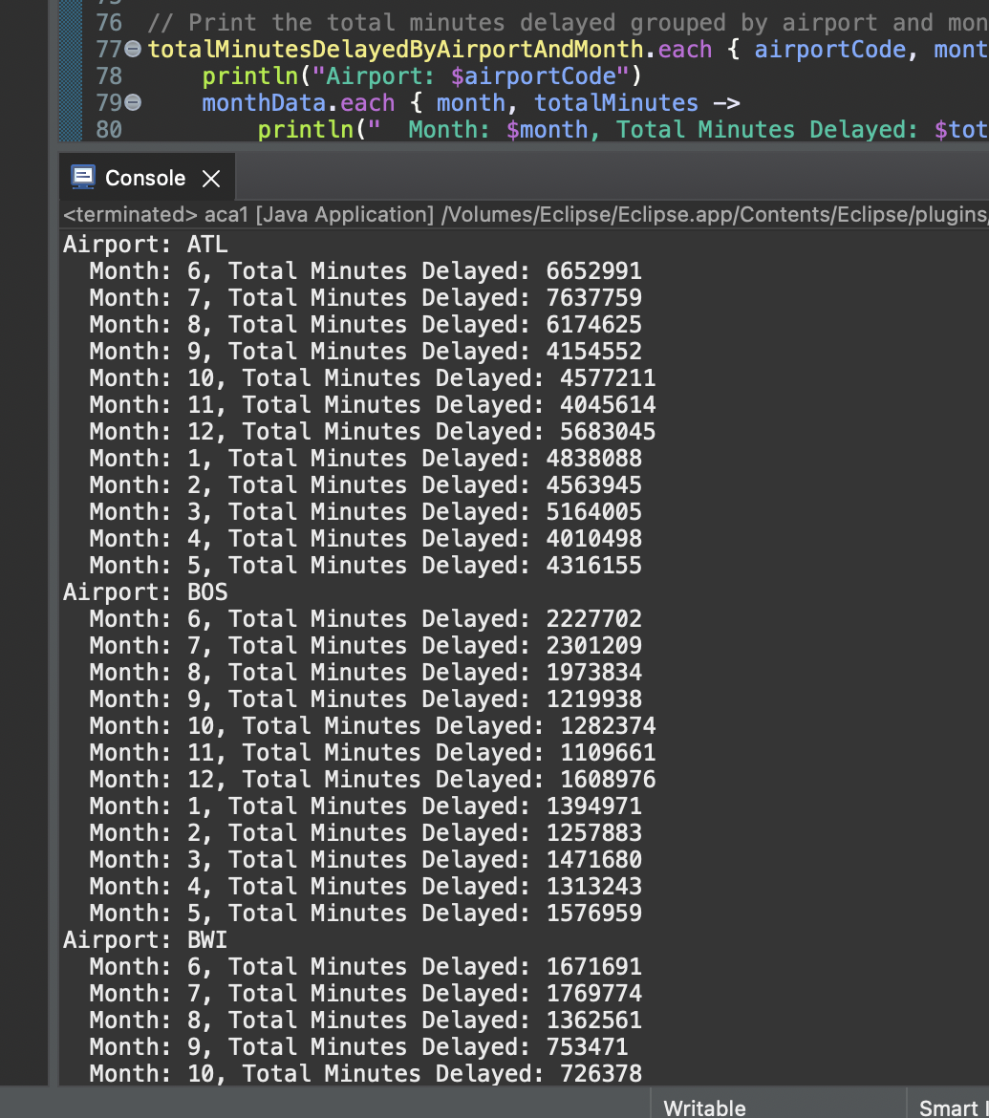
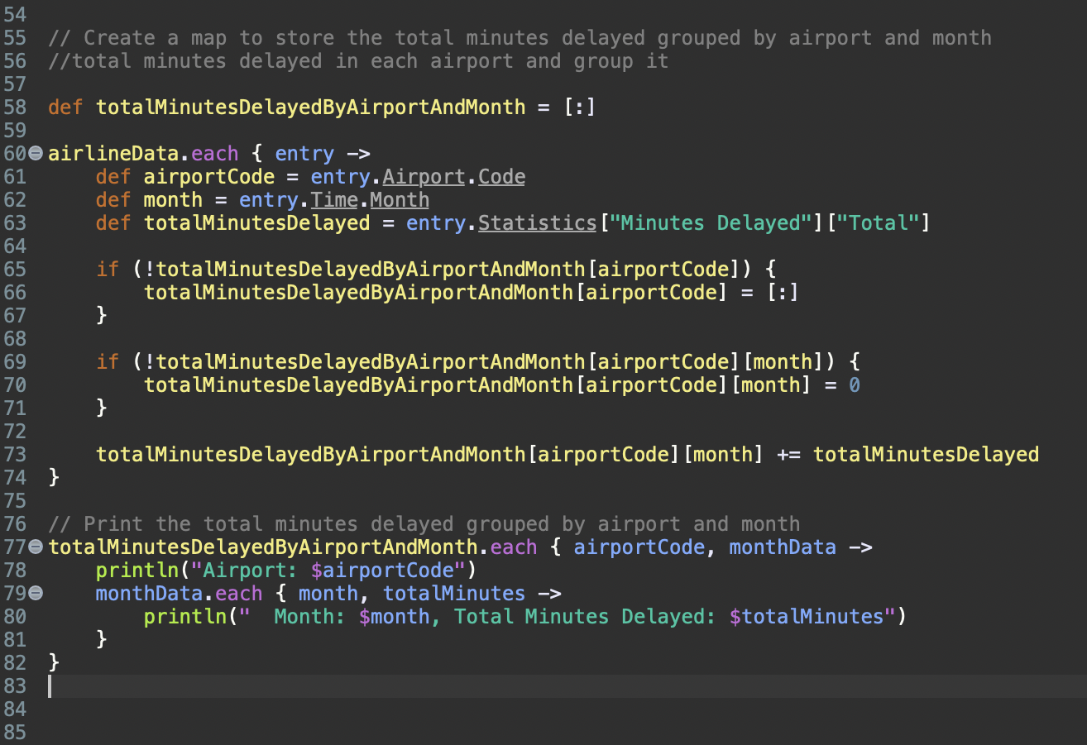
Query 2 - Data Grouping
Create a map to store the total minutes delayed grouped by airport and month
Total minutes delayed in each airport and group it
Code: Output:
User-aam79

Slide 5
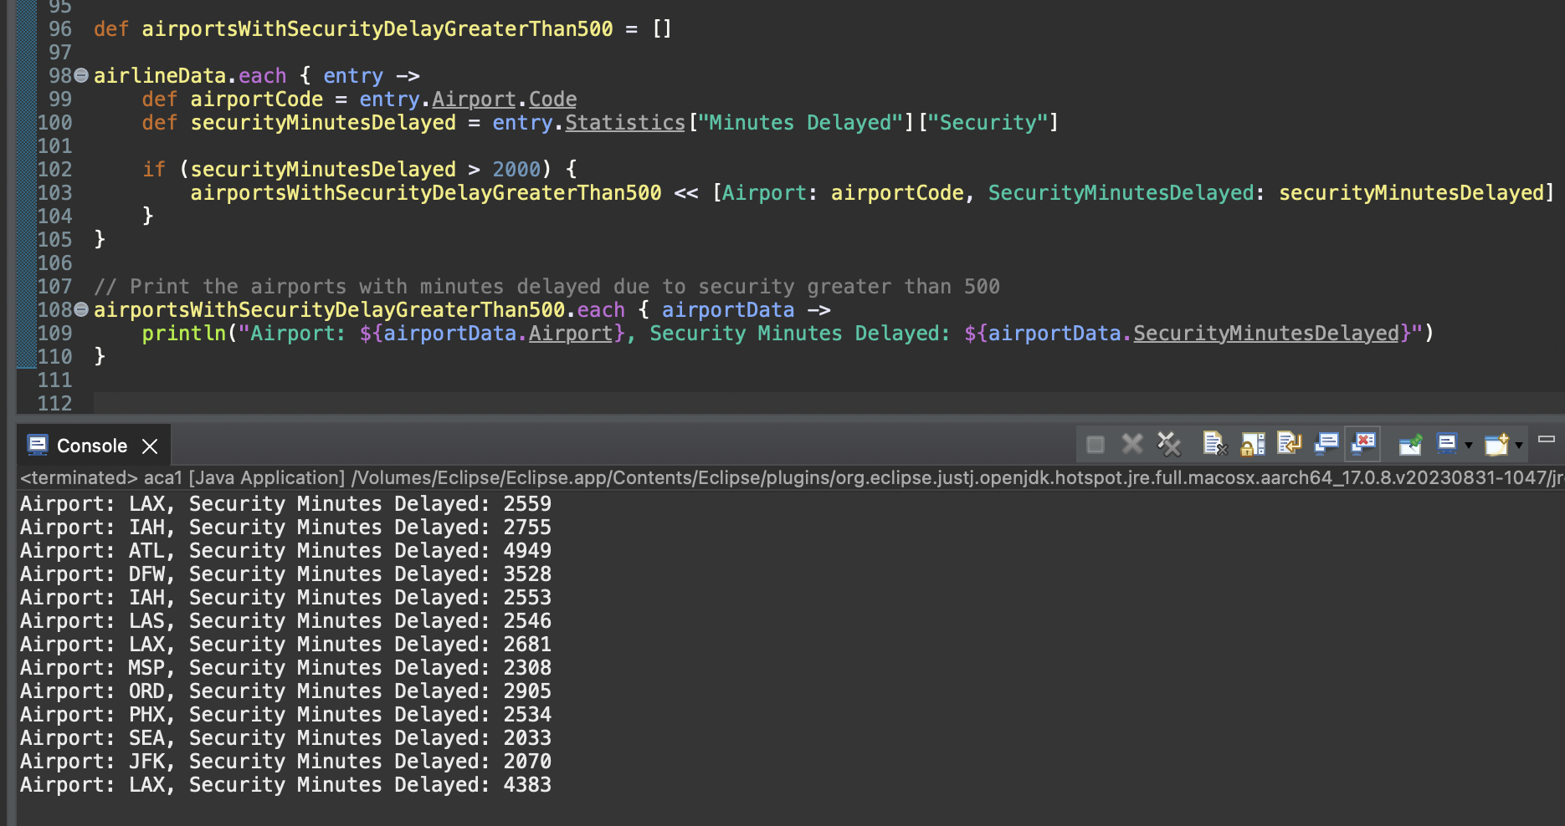
Query 3 – Data Filtering
Create a list to store the airports with minutes delayed due to security greater than 2000
Query for each airport where minutes delayed due to security is greater than 2000
Code & Output:
User-aam79

Slide 6
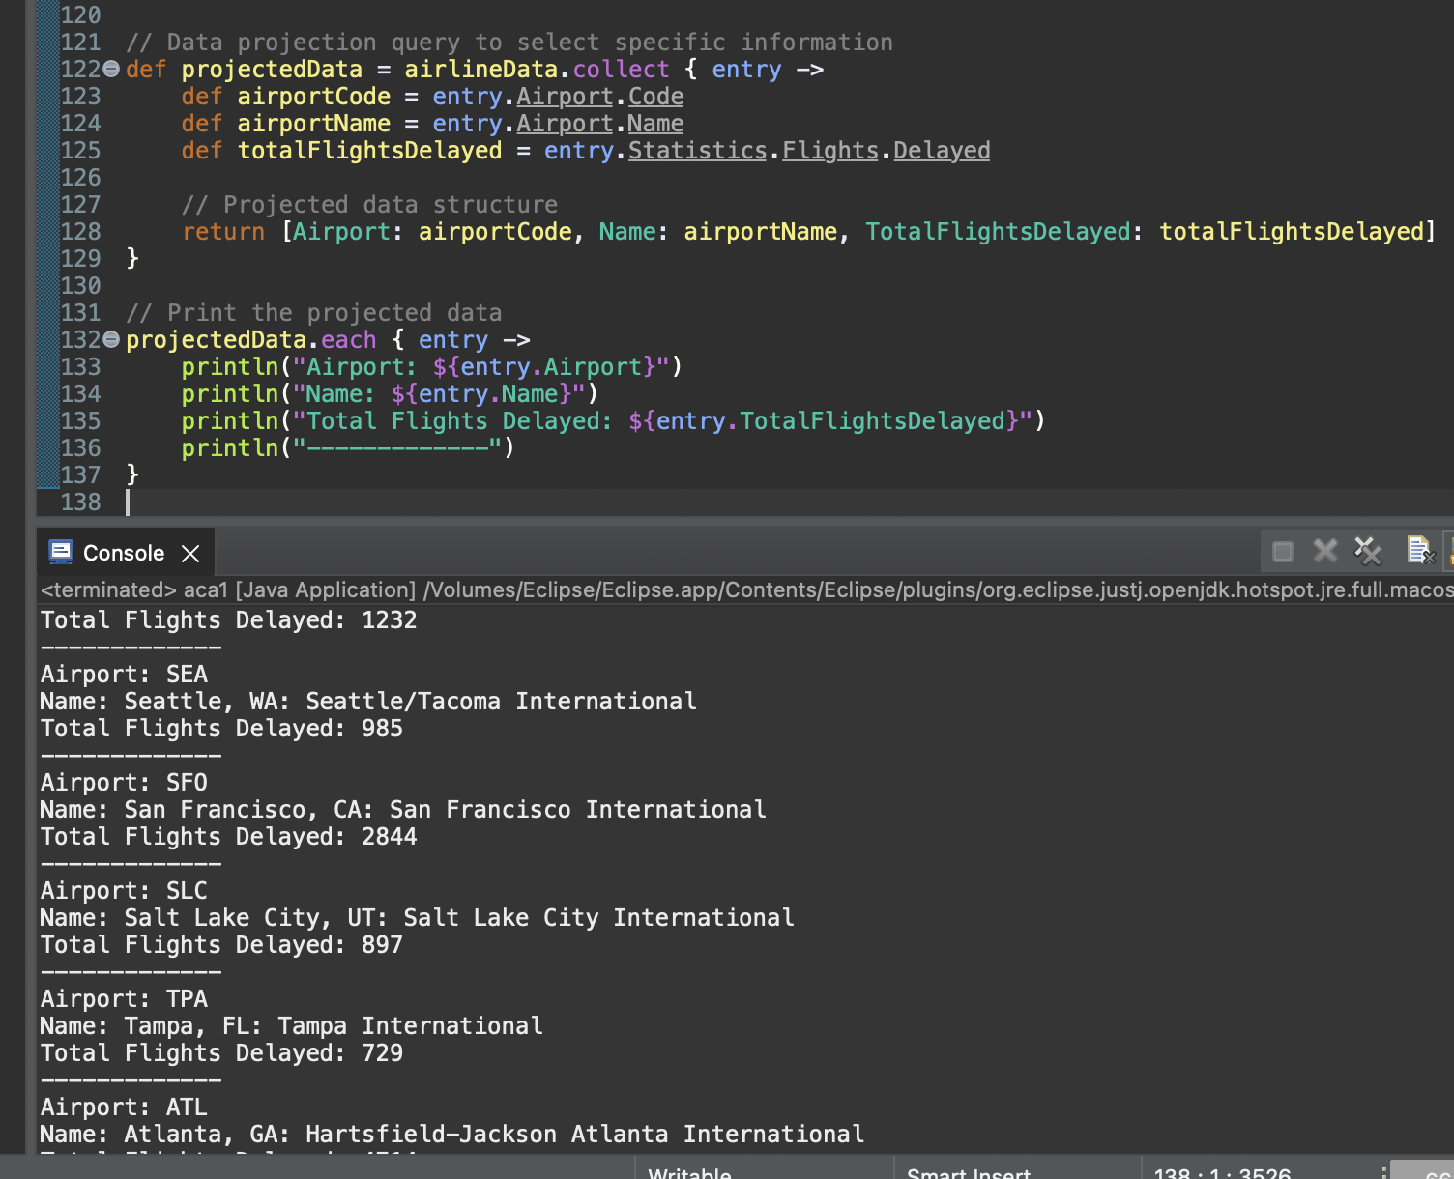
Query 4 - Data Projection
Data projection query to select specific information
Code & Output:
User-aam79

Slide 7
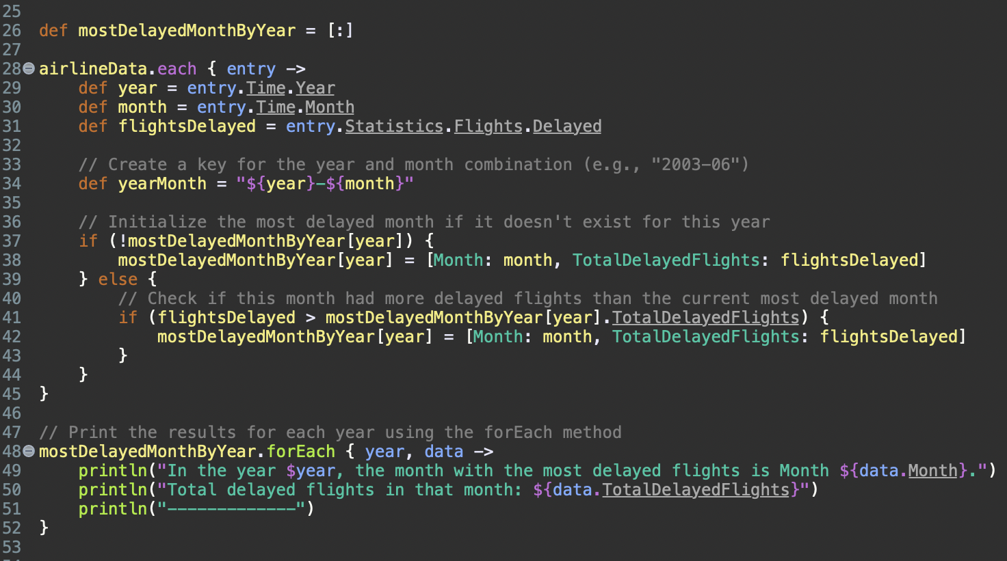
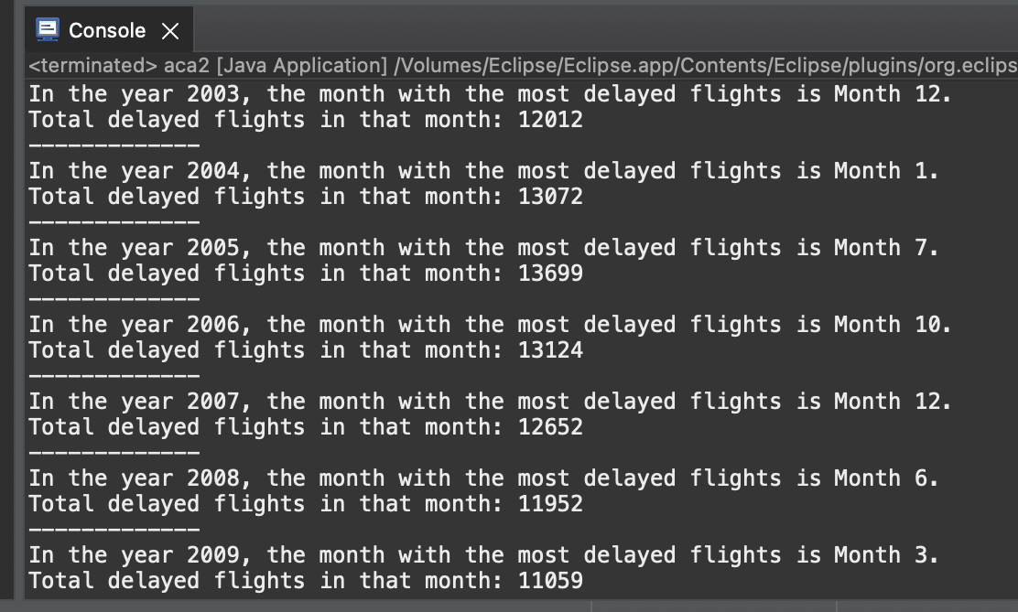
Exercise 2 Query 1 – Data Filtering
Initialize a map to track the month with the most delayed flights for each year
Query to find the month in every year which recorded the most delays (Using forEach Method)
Code:
Output:
User-rep32

Slide 8
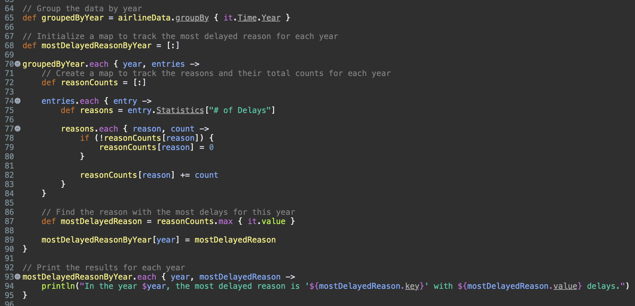
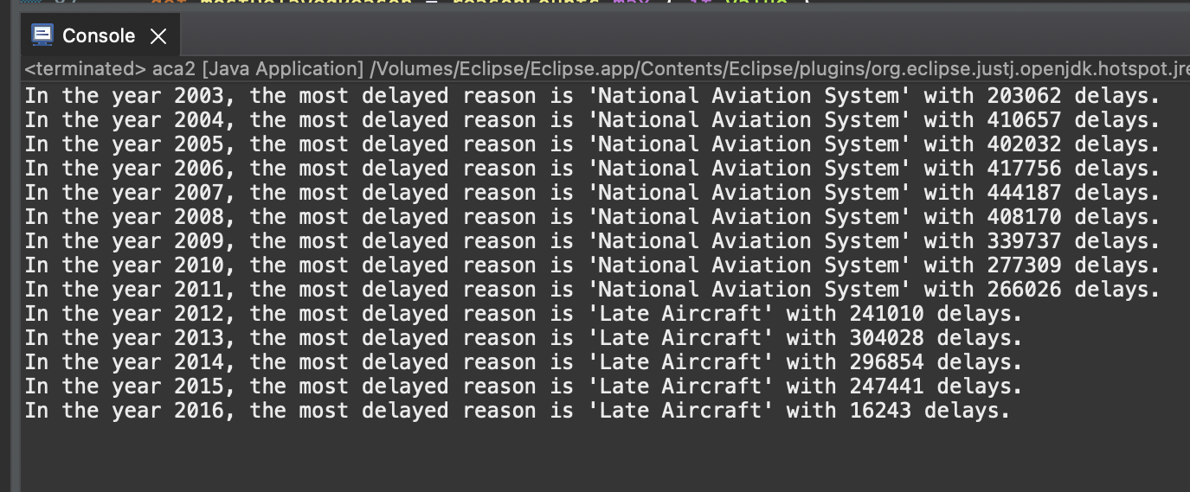
Query 2 – Data Grouping
In a calender year the reason which caused the most number of delays (Using GroupBy Method)
Code:
Output:
User-rep32

Slide 9
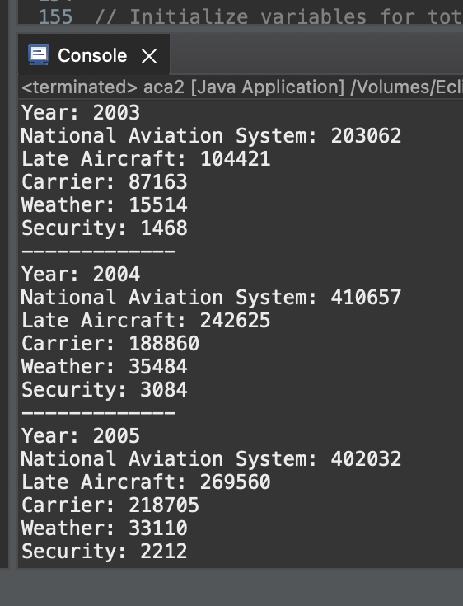
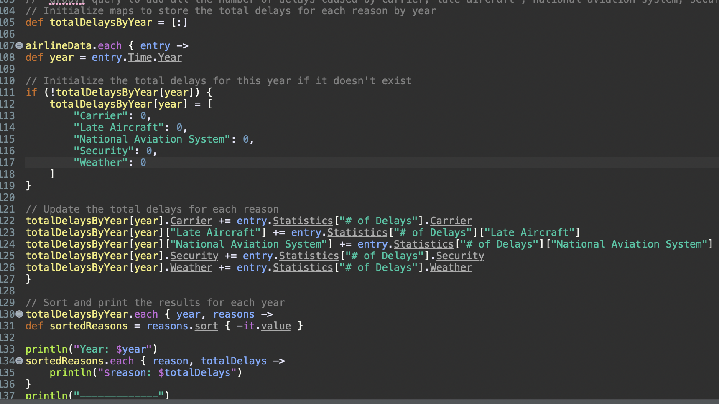
Query 3 – Data Combination
Query to add all the number of delays caused by carrier, late aircraft , national aviation system, security and weather in each year separately and after that sort them in descending order in terms of the reasons which caused the most delays
Initialize maps to store the total delays for each reason by year
Output:
Code:
User-rep32

Slide 10
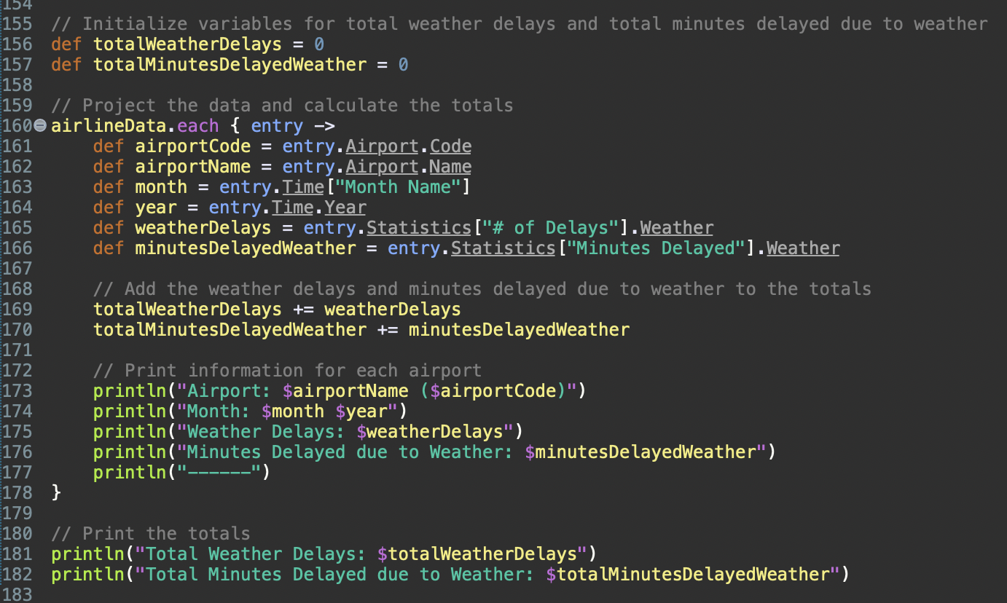
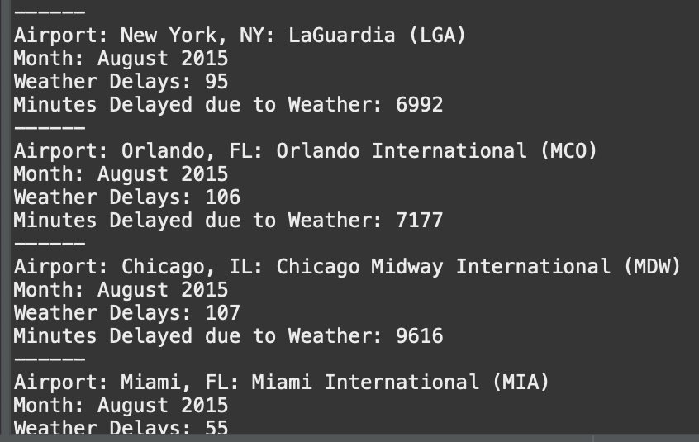
Query 4 – Data Projection
Using Data projection we have calculated the total weather delays and also calculated the total minutes in the weather delay and printing the information for the each airport
Code:
Output:
User-rep32

Slide 11
Exercise 3:
MongoDB
MongoDB is a popular open-source NoSQL database management system known for its flexibility, scalability, and ease of use.
MongoDB is designed to handle large volumes
User-gv58

Slide 12
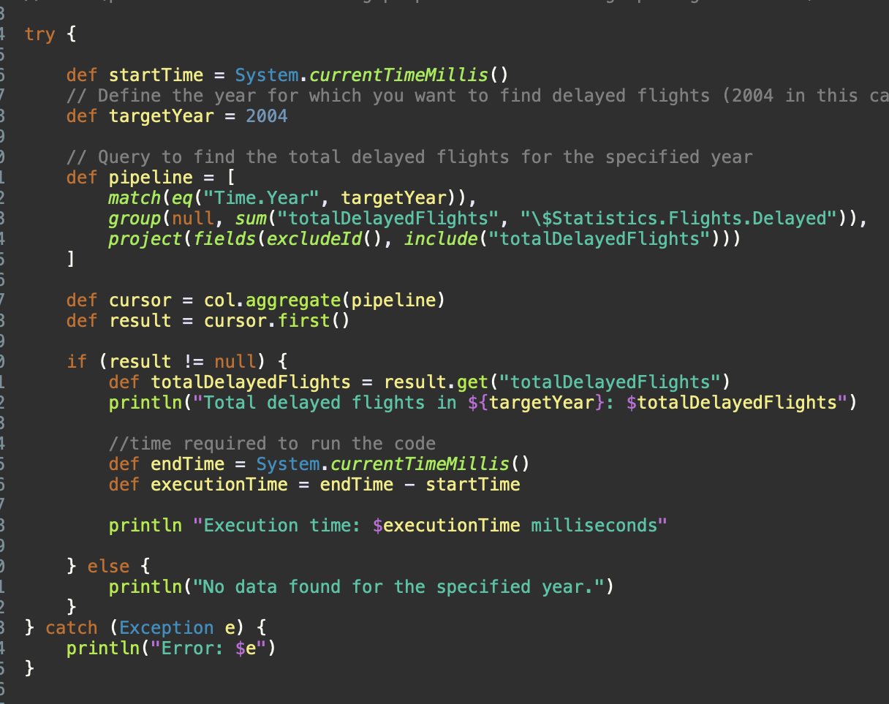
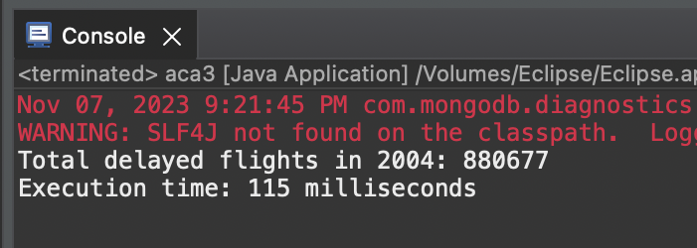
Query 1 - Query to find the total flights delayed in the year 2004
Code :
Output:
User-gv58

Slide 13
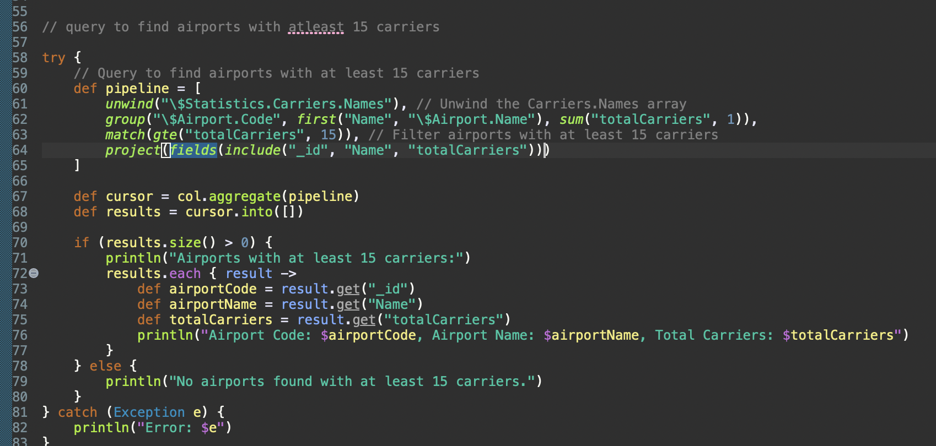
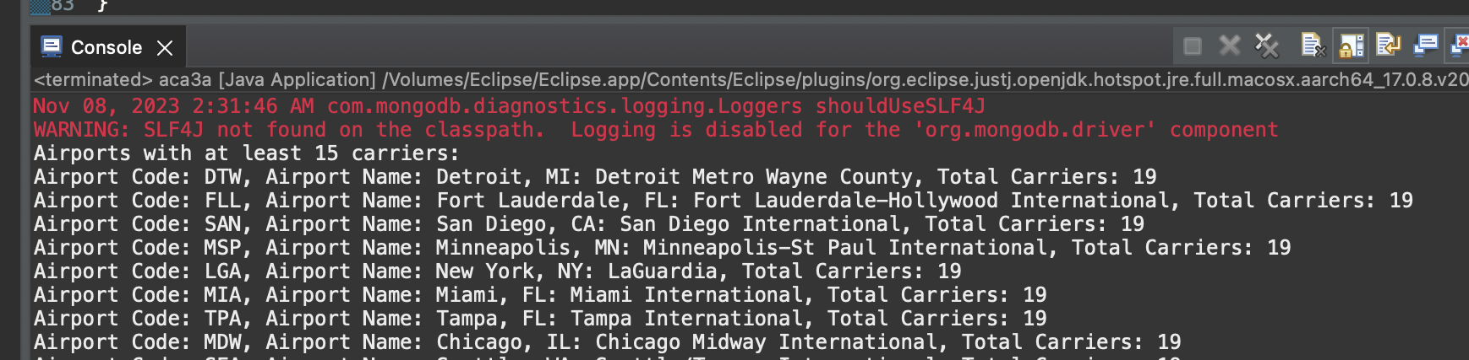
Query 2 -
Query to find airports with at least 150 carriers
Code:
Output:
User-gv58

Slide 14
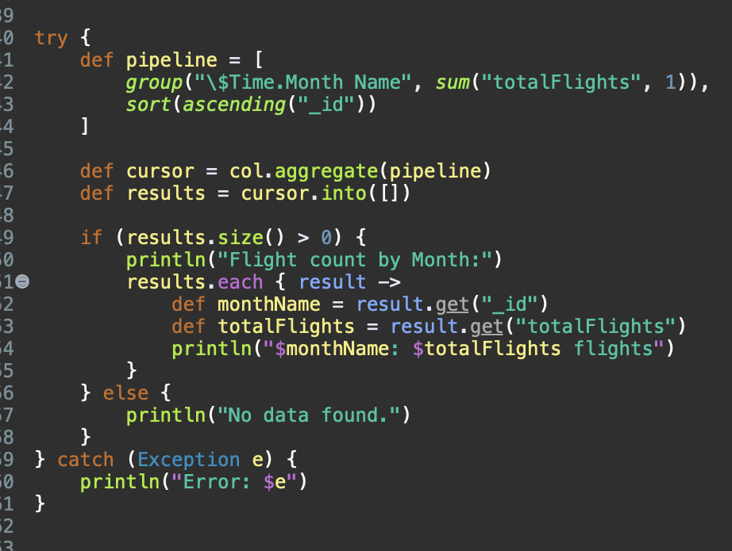
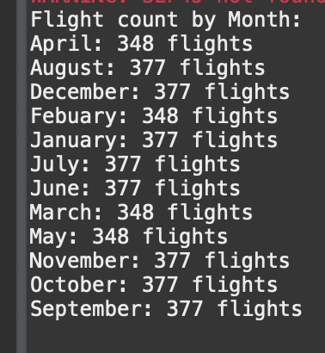
Query 3 -
Query to find the flight count by month
Output:
Code:
User-gv58

Slide 15
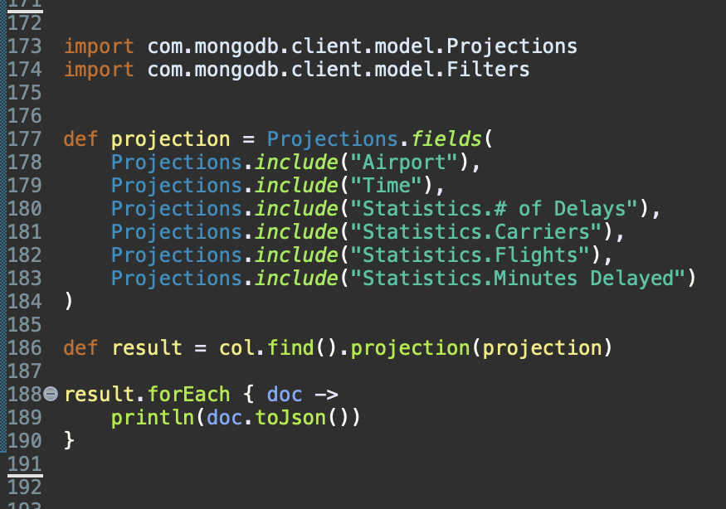
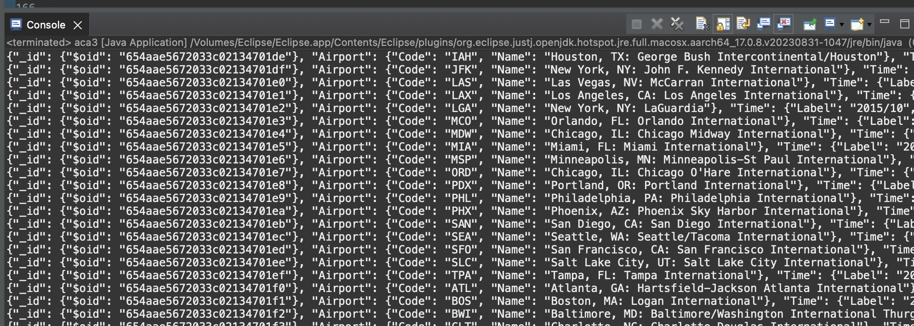
Query 4 – Data Projection
Simple projection query for the MongoDB Data
Code:
Output:
User-gv58

Slide 16
Exercise 4:
Stand-alone Groovy vs Cloud-based solution
Aspect | Groovy with JSON | Groovy with MongoDB
Data Storage | JSON data is typically stored in files or as text | MongoDB is a NoSQL database that stores data in a structured document format, similar to JSON. Data is stored in collections.
Data Query and Retrieval | Groovy can parse and manipulate JSON data easily | MongoDB provides a powerful query language to retrieve and manipulate data. Queries are expressed in a JSON-like format.
Schema and Flexibility | JSON is schema-less, allowing flexibility in data structure. Data can vary between JSON objects. | MongoDB also provides schema flexibility, allowing different documents in a collection to have varying structures.
Transactions | JSON doesn't inherently support transactions | MongoDB has limited support for multi-document transactions, providing better support for data consistency.
Indexing and Query Optimization | JSON requires external tools for indexing and query optimization. | MongoDB has built-in indexing and query optimization features for improved query performance.
Aggregation Framework | Groovy can perform basic data aggregation using in-memory operations | MongoDB includes a powerful aggregation framework for complex data aggregation and transformation.
User-ab1258

Slide 17
Data Relationships | Handling relationships in JSON often involves denormalization or maintaining references to related data | MongoDB supports embedding and referencing related data, making it easier to manage relationships within documents.
Scalability | Limited scalability options without additional tools | MongoDB is designed for horizontal scalability and can distribute data across multiple nodes for high scalability.
ACID Compliance | JSON does not provide built-in ACID compliance for transactions | MongoDB offers ACID compliance for individual operations and, with proper configuration, supports multi-document transactions.
Use Cases | Suitable for simple data storage, configuration files, or data interchange | Suitable for complex data storage, real-time applications, analytics, and use cases requiring high scalability and flexibility.
User-ab1258

Slide 18
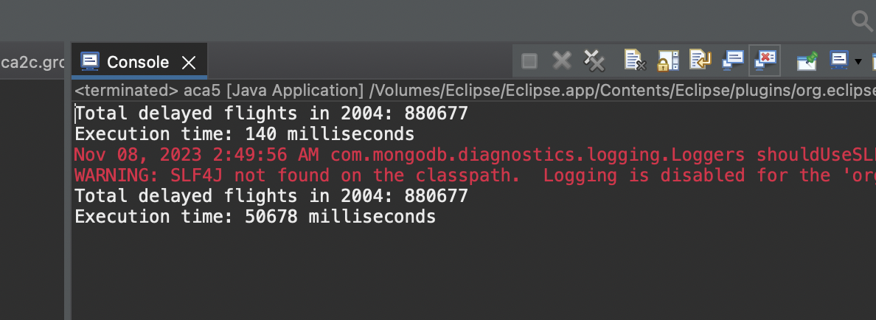
Keep in mind that the choice between using Groovy with JSON and Groovy with MongoDB depends on your specific use case and requirements. JSON is lightweight and simple, whereas MongoDB offers more advanced database features and scalability for larger and more complex applications.
User-ab1258

Slide 19
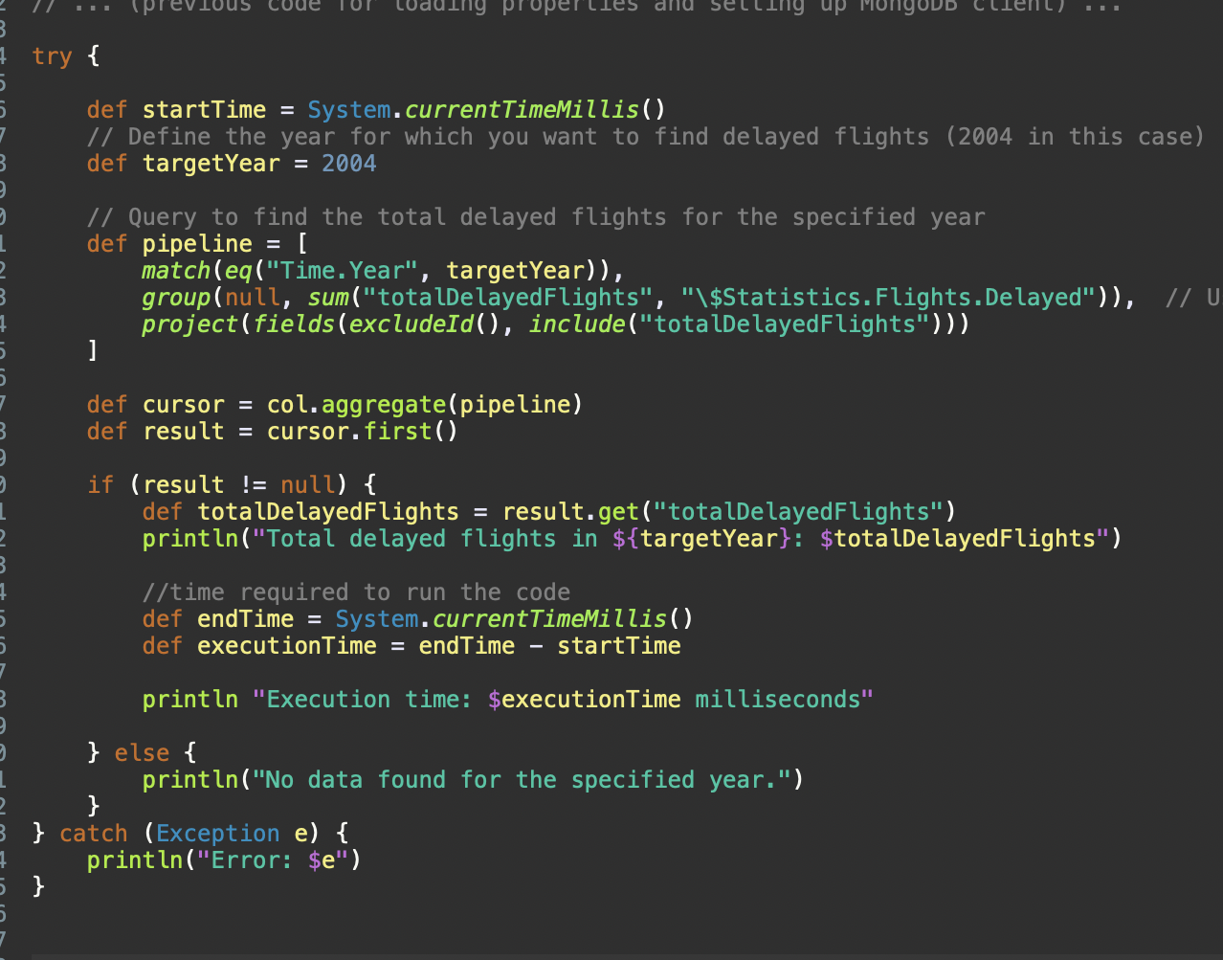
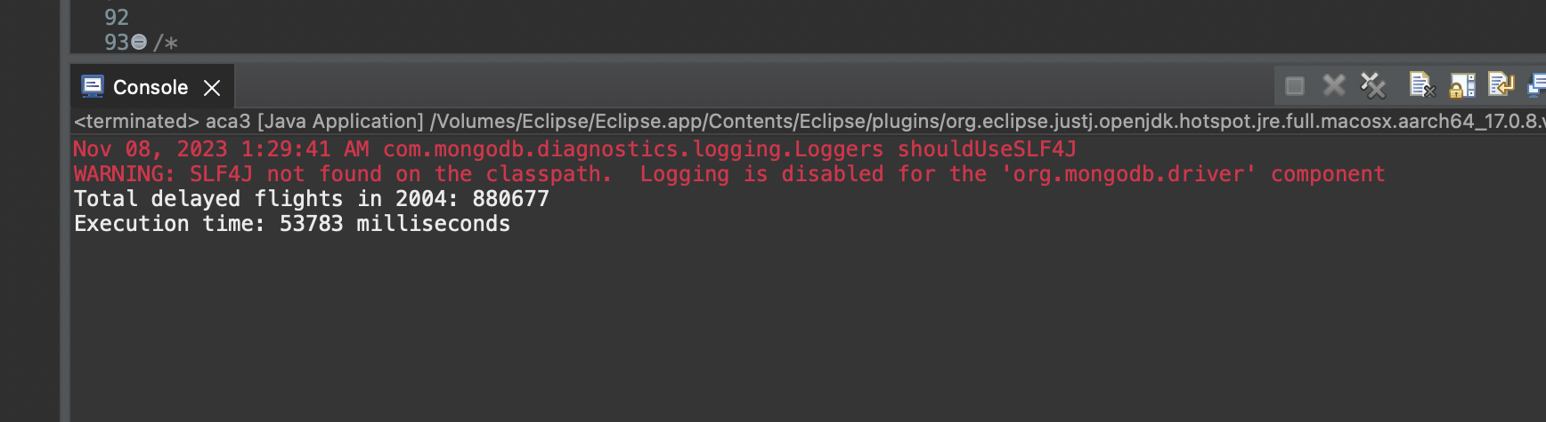
Performance Query to find the total flights delayed in the year 2004 (MongoDB Version) Code: Output:
Exercise 5:
User-am1501

Slide 20
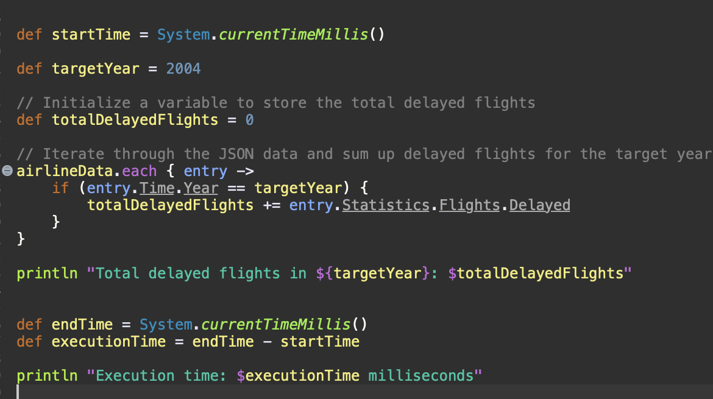
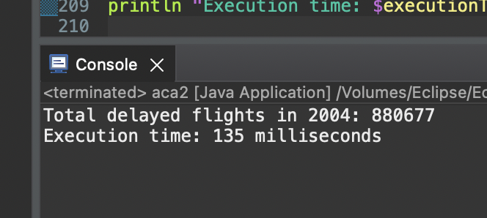
Performance Query to find the total flights delayed in the year 2004 (Groovy Version) Code: Output:
User-am1501

Slide 21
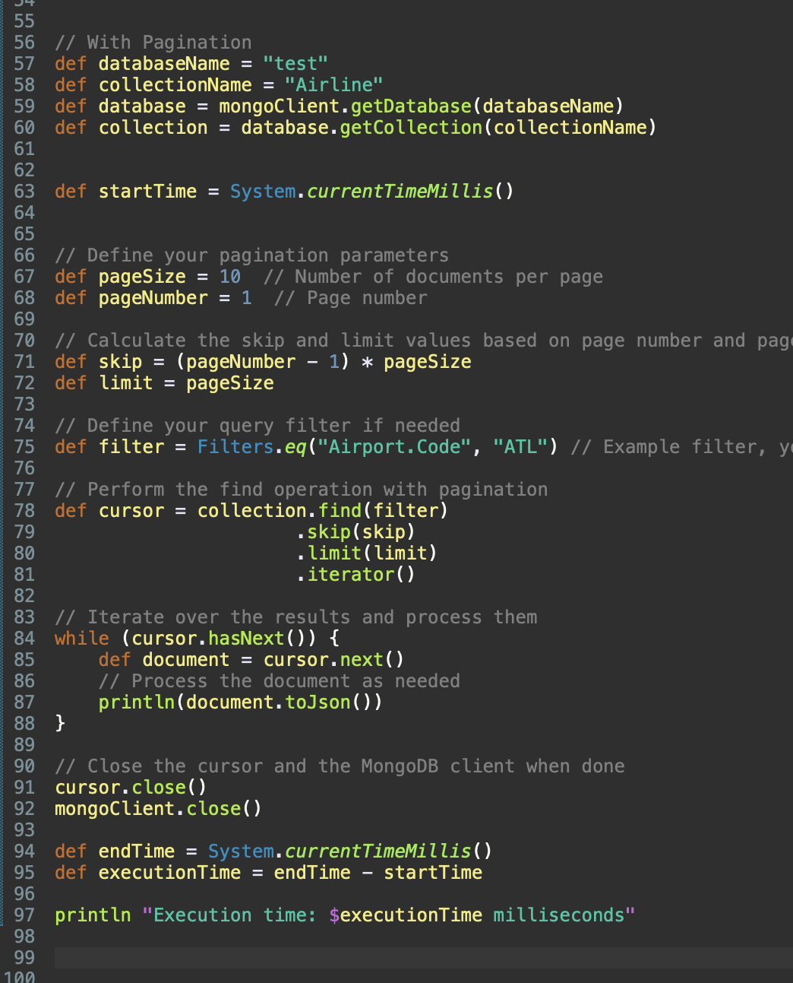
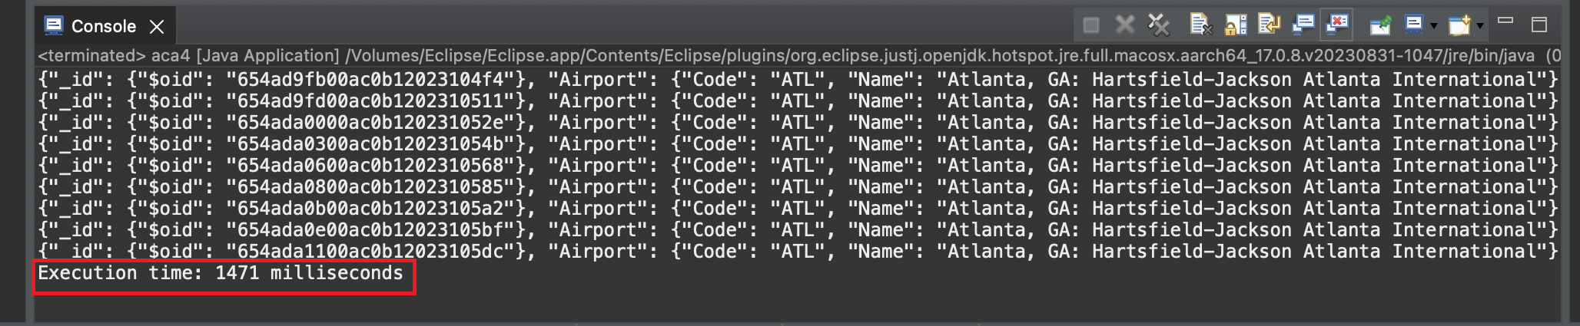
Scalability With Pagination
Code: Output:
User-am1501

Slide 22
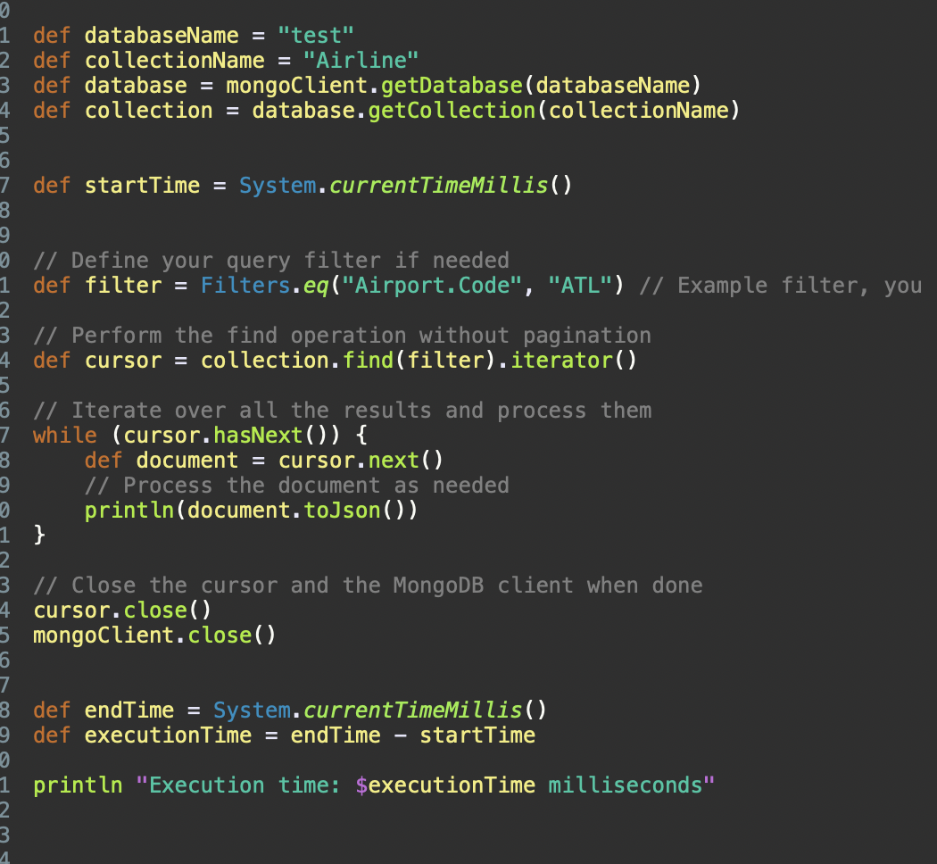
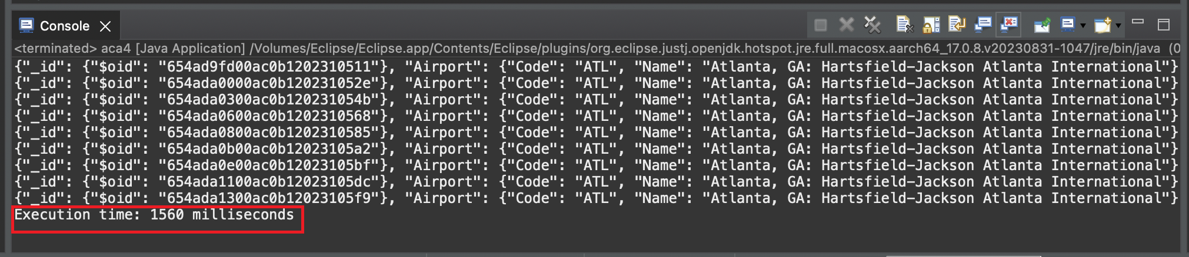
Scalability without pagination
Code:
Output:
User-am1501

Slide 23
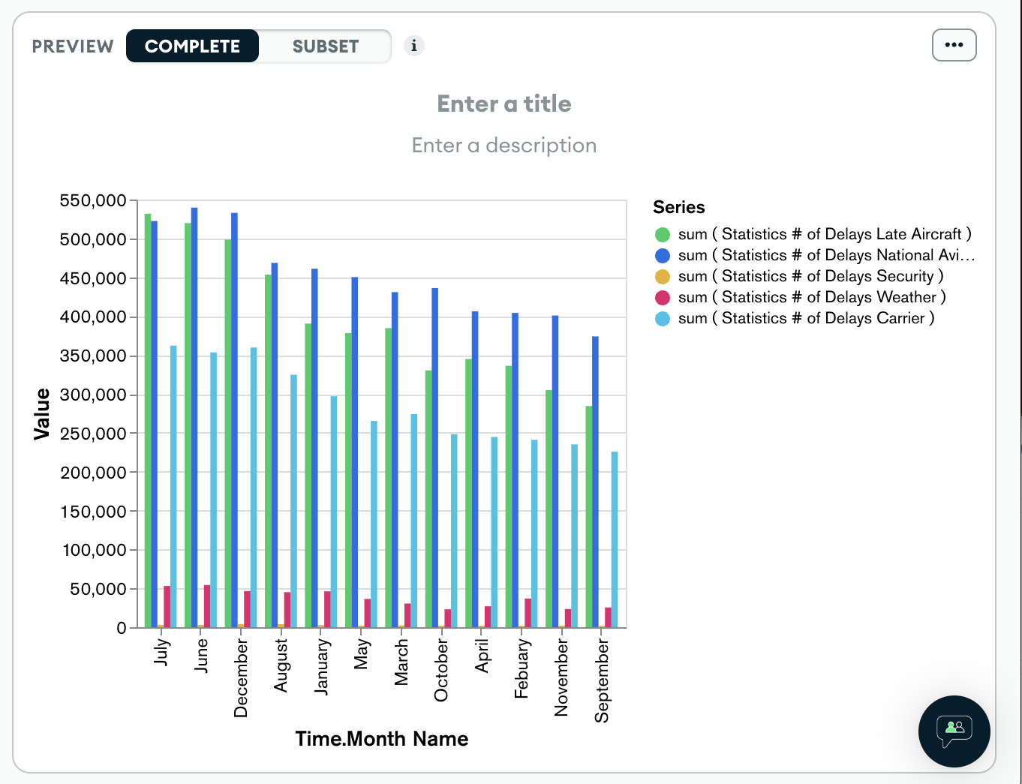
Scalability :
Month vs delays
User-am1501

Slide 24
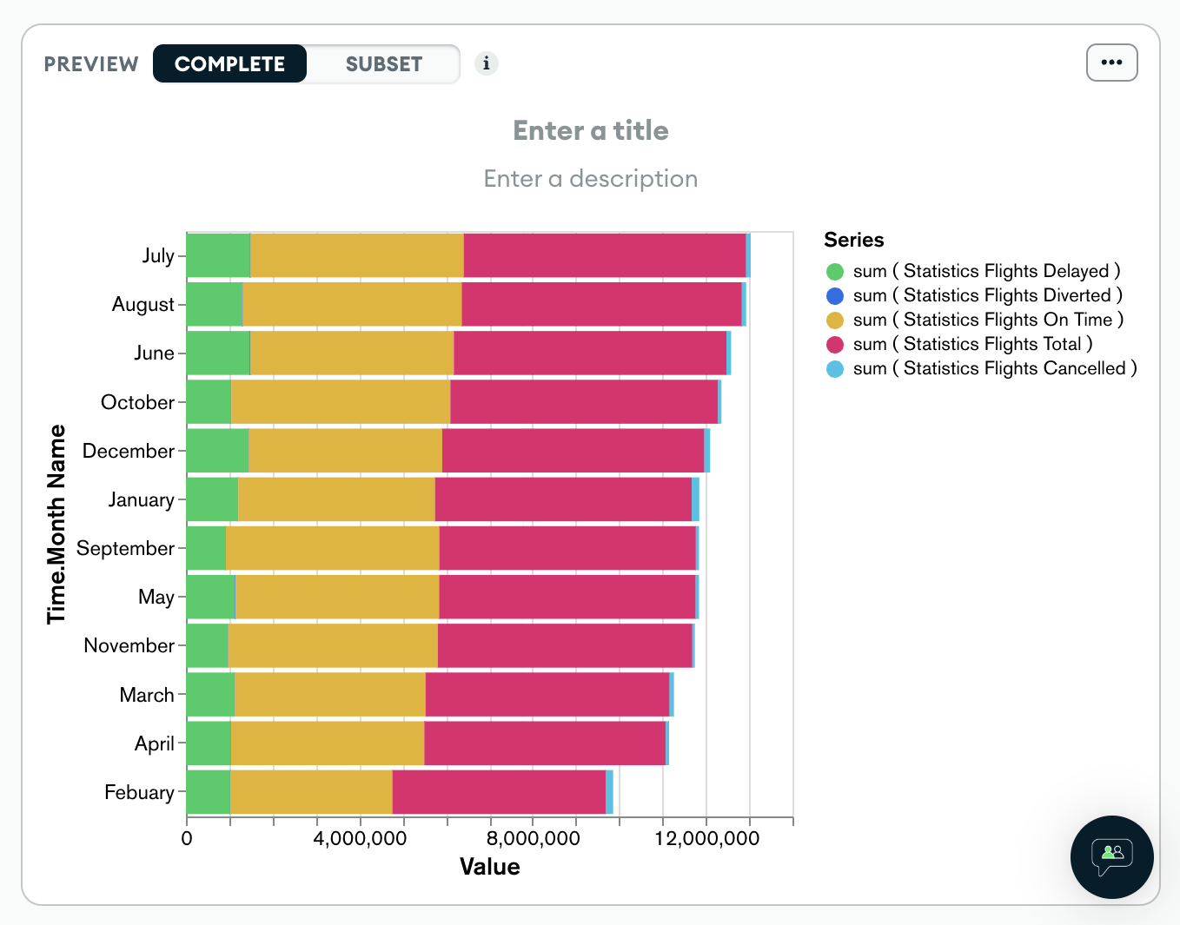
Month vs flights
User-am1501

Slide 25
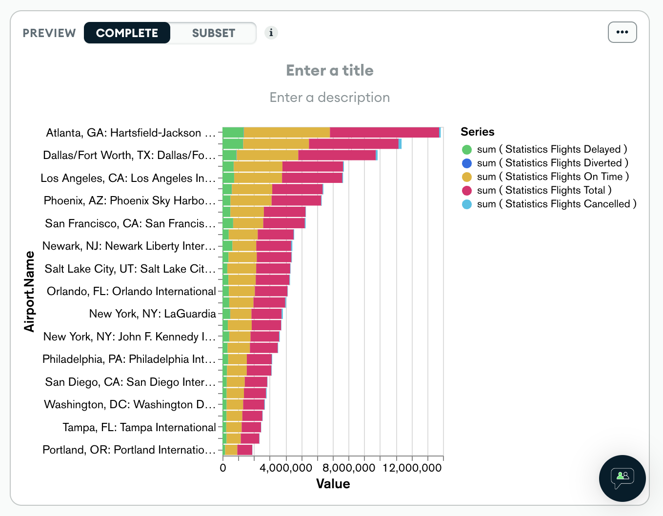
Airport vs Flights
User-am1501

Slide 26
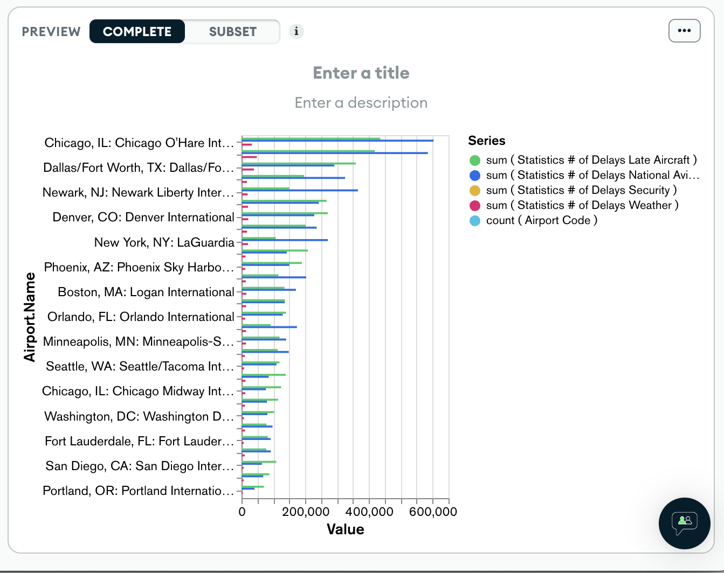
Airport vs Delays
User-am1501

Slide 27
Conclusion :
In conclusion, MongoDB and Groovy serve different primary purposes. MongoDB is a database specifically designed for efficient data storage and retrieval, particularly in scenarios with unstructured or semi-structured data and high scalability needs.
Groovy, on the other hand, is a general-purpose scripting language that is exceptionally well-suited for data parsing, manipulation, and interaction with databases, but it doesn't replace the role of a database like MongoDB.
For many projects, a combination of MongoDB and Groovy can be powerful. You can use MongoDB to store and retrieve data efficiently and leverage Groovy for data transformation and processing tasks. The choice between the two should be based on the specific requirements of your project and how they align with the strengths and use cases of each technology.

